Slide 1

Building a
Better Budget

Slide 2
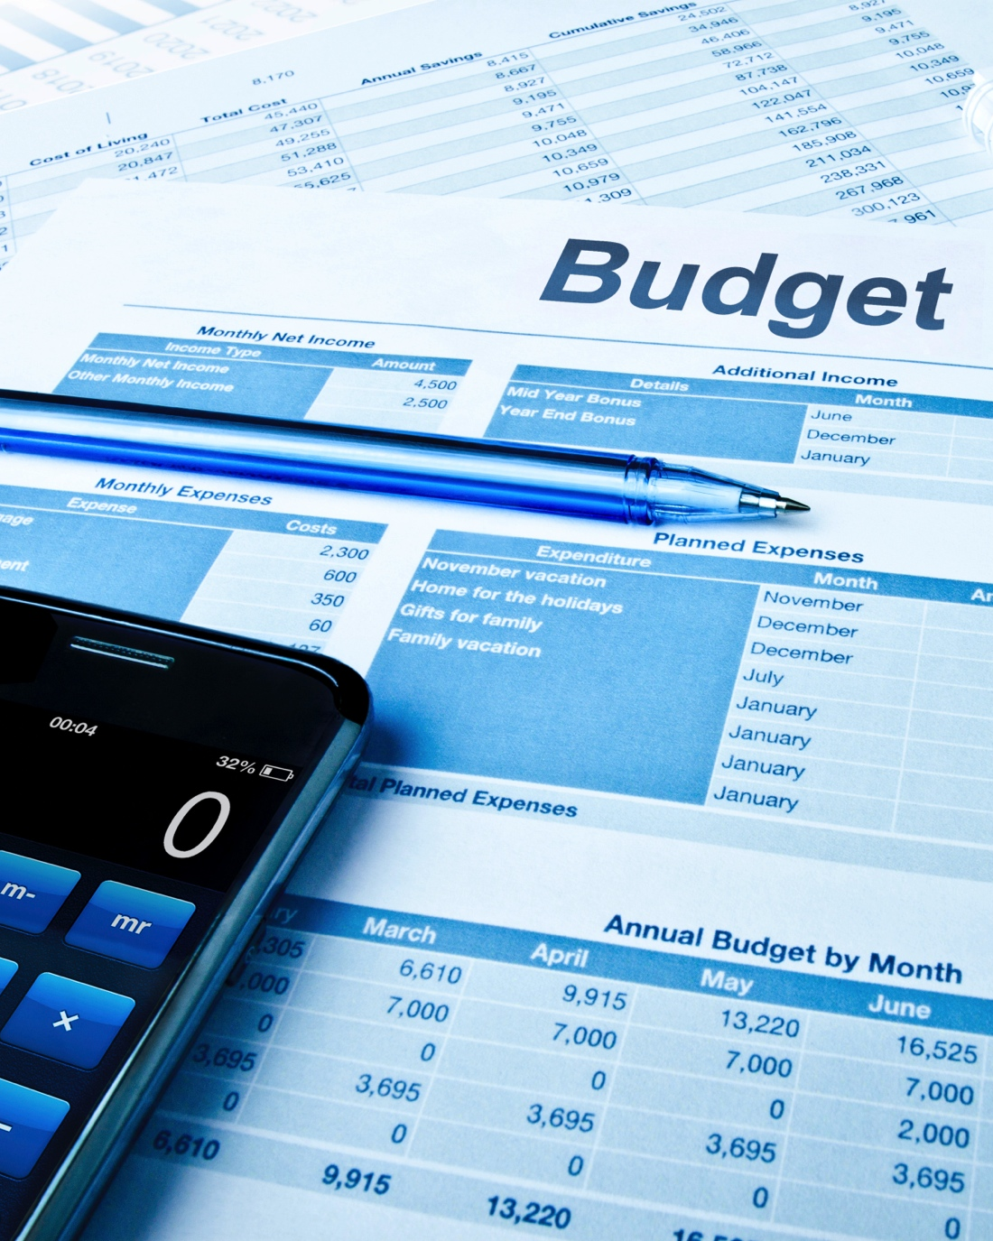
Building a
Better Budget
If you are one of the many people for whom the word “budget” is the same as the word “denial,” you may be surprised
to learn that the opposite is true. A
well-designed budget is the best way for you to reach goals and achieve financial independence – without having to sacrifice all of life’s pleasures.

Slide 3

Why Budget?
Achieve goals
Use money efficiently
Become financially secure
One rule: expenses < income

Slide 4

Obstacles to
Getting Started
Easy to procrastinate
Feeling there is never
enough money
Hard to confront past decisions
Goals are overwhelming
Fear lifestyle changes

Slide 5
Characteristics of Goals
1
2
3
4
5
Specific
Measurable
Attainable
Realistic
Time-bound

Slide 6
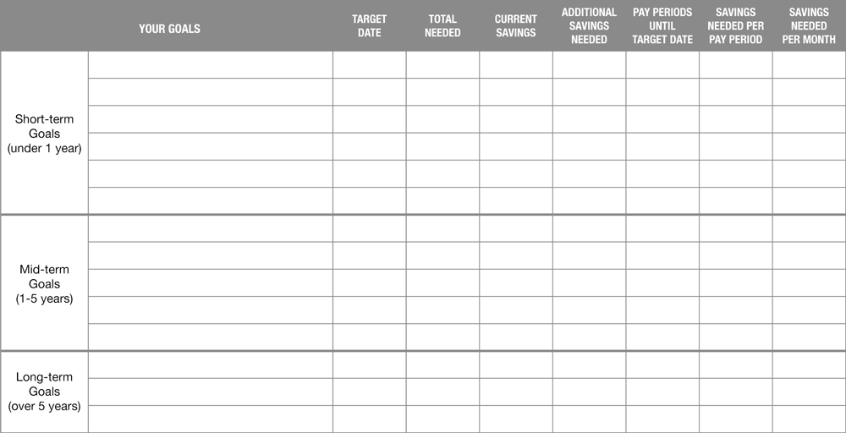
Financial Goal Chart

Slide 7
Sample Goals
Goal type | Goal | Target date | Total needed | Monthly deposit
Short-term | Emergency savings account | 1 Year | $1,800 | $150
Mid-term | Repay debt | 3 Years | $5,000 | $200
Long-term | Fund retirement | 30 Years | $1,000,000 | $350
Total monthly savings for all goals |  |  |  | $700

Slide 8

Establish an Emergency Account
3-6 months of essential
living expenses
Liquid account
Create fund while working toward other goals

Slide 9
Save for Goals While Repaying Debt
Should save for emergency fund even if have debt
- Won’t have to rely on credit if there is an emergency
Save for retirement
- Reduces taxable income
- Many employers match contributions
May want to delay saving for less vital goals
- Interest charged on debt

Slide 10
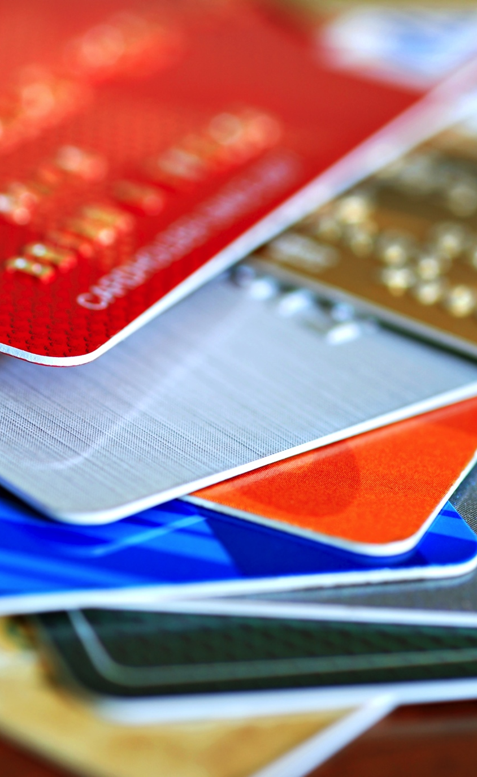
Credit Card Example
$2,000 balance
19.8% APR
Minimum payment 2.5% of balance or $20, whichever is higher
Make only the minimum payments:
- It will take almost 14.5 years to repay
- It will cost $2,848 in interest

Slide 11

Start Saving Now
We spend what we make
Automate it!
Don’t wait until after
bills are paid
“You” are an
essential expense

Slide 12

Track Where It Goes
Write it all down
Keep receipts
Use debit or credit card
Monitor ATM use
Use expense tracking software

Slide 13



Construct the Budget
Paper budget form
Online budget form
Spreadsheet

Slide 14

Income
Be conservative with
non-guaranteed income
- Overtime
- Bonuses
- Fluctuating income
- Commissions
- Seasonal
If get large refund,
may want to adjust
tax withholdings

Slide 15

Expenses
Two columns – current
and proposed
In “current” column, list all
current expenses:
- Fixed
- Variable/Periodic
Subtract total from income
Make changes if needed
- Essential vs. discretionary
- Add goals

Slide 16
Action Items
1
2
3
Increase income
Decrease spending
Don’t forget goals!
Overtime, part-time, better pay, sell things
Reduce, substitute, postpone, forego

Slide 17

Budget Busters –
Debt
Understand positive debt vs. negative debt
Don’t charge more than
can pay off in full
Seek lower interest rates

Slide 18
Budget Busters –
Spending
Money Choice Assessment
- Do I need it?
- Do I need it now?
- What would happen if
didn’t have it?

Slide 19

Stay Motivated
Visualize success
Stay organized
Be realistic
Monitor progress
Expect setbacks
Reward yourself
along the way

Slide 20
What are you going to do now?
What can you do today/in 3 months/this year?
Draw up a milestone calendar
Remember – a budget is a springboard to
financial independence
Have patience – success doesn’t happen
overnight but over time

Slide 21




Find Us On Social Media

